Slide 1

Color analysis and image processing applied in fruit analysis
Batch Members:
B.Keerthana (2010030017)
M.Nissie (2010030095)
M. Sravani (2010030104)
P.Mounika (2010030485)
Supervisor:
Name : Mr. Chanda Rajkumar
Designation : Professor, CSE

Slide 2
Abstract
India is also known as Agricultural Country. Fruit and Vegetable play a vital role in the Indian economy. color and appearance are the first attributes that attract us to a fruit or vegetable.
By using image Processing Technique the rotten part of fruits and vegetables is detects effetely to separate unhealthy from a good one.
This method of detecting a defective object is carried out by using different library functions Python Software. Finally, the notification of the spoiled fruits and vegetables is intimated to the user by displaying the Message in the display.
The purpose of this project is to give an overview of the recent development of image processing applied to color analysis from horticultural products, more specifically the practical usage of color image analysis in agriculture.

Slide 3
Introduction
The features are one of the key parameters to define the quality of an agricultural product. The color is probably the first factor that consumers use to determine the appearance of a product; appearance is a subjective factor that leads the consumer to accept or reject a food product.
Fruits can be classified based on their appearance and parameters like color, size, shape, etc. These parameters can be used to determine their quality and classify them.
The adaptation of the human eye to slight changes in color and the effect of the background on the perceived color and color intensity are the major drawbacks of visual inspection. To make decisions consistent, machine vision technology based on image analysis using color has proved to be the best technique to determine the quality of fruits.
A considerable effort has been made in the area of automation to improve the quality of agricultural products in the food industry to decrease losses. We are trying to find out whether the considered dataset is useful or not.

Slide 4
Literature Survey
Title of the Paper | Description | Publication Details | Web Link
Analysis and Recognition Based on Citrus Color Grading Model considering Computer Vision Technology | In this paper, the characteristics of fruit images under three different lighting conditions, that is, front lighting, back lighting, and normal lighting, are identified based on exploratory data analysis by using the computer vision technology. The results of the experiment in the study indicate that based on the color threshold selected, the mature citrus fruits can be can effectively identified, and the overall recognition rate has exceeded 98%, which can meet the requirements for intelligent harvesting. | Hindawi Volume 2021 |Article ID 6426163 | Chongqing Municipal Education Commission | Analysis and Recognition Based on Citrus Color Grading Model considering Computer Vision Technology (hindawi.com)

Slide 5
Title of the Paper | Description | Publication Details | Web Link
A Framework with OTSU’S Thresholding Method for Fruits and Vegetables Image Segmentation | In this paper they have presented the related work of all type of image segmentation method. For background subtraction Otsu's algorithms are used which are based on thresholding image segmentation method. This approach is evaluating on database of different category of fruits and vegetables. In the data set we have not consider the combination of different fruits and vegetables. They have considered same kind of fruits and vegetables with different pose and also variability in number. For future enhancement they are trying to identify fruits and vegetables based on color and texture methods | International Journal of Computer Applications (0975 – 8887) Volume 179 – No.52, June 2018 | (PDF) A Framework with OTSU’S Thresholding Method for Fruits and Vegetables Image Segmentation (researchgate.net)

Slide 6
Title of the Paper | Description | Publication Details | Web Link
Design And Detection Of Fruits And Vegetable Spoiled Detection System | The identification of normal and defective fruits based on quality using OPENCV/PYTHON is successfully done with accuracy. The use of image processing for identifying the quality can be applied not only to any particular fruit. We can apply this method to identify quality of vegetables with more accuracy. The system is operated in two different scenarios in first the image is captured then all the image processing is done All the process are shown on monitor and based on decision taken by control module. The conveyor assembly is operated. this can be extracted in future as the fruit or vegetables is affected by its inside or not. | International Journal of Application or Innovation in Engineering & Management (IJAIEM) Volume 10, Issue 6, June 2021 | IJAIEM-2021-06-17-8.pdf

Slide 7
Title of the Paper | Description | Publication Details | Web Link
Food Quality Inspection and Grading Using Efficient Image Segmentation and Machine Learning-Based System | In this first Gaussian elimination method is used on photos to remove noise. After that, histogram equalization is employed to enhance the image’s quality. The K-means clustering algorithm is used to segment the images. The following stage utilizes machine learning methods such as KNN, SVM, and C4.5 to classify fruit photos. These algorithms determine whether fruits are healthy or unhealthy. Three factors are considered in a comparative study: accuracy, specificity, and sensitivity. SVM accuracy is higher than other methods. future researchers in determining the most appropriate machine learning technique for food grading and quality assurance. | Hindawi Volume 2022 |Article ID 5262294 | s40595-014-0028-3.pdf (springer.com)

Slide 8
Existing System
Support Vector Machine
Support Vector Machine or SVM is one of the most popular Supervised Learning algorithms.
which is used for Classification as well as Regression problems. However, primarily, it is used for Classification problems in Machine Learning.
SVM chooses the extreme points/vectors that help in creating the hyperplane. These extreme cases are called as support vectors, and hence algorithm is termed as Support Vector Machine.
In SVM linear after training and testing the accuracy, classification the data had a problem of hardware capacity to process it.
SVM algorithm is not suitable for large data sets. SVM does not perform very well when the data set has more noise i.e. target classes are overlapping.

Slide 9
Proposed System
Convolution Neural network (CNN)
Deep Learning has proved to be a very powerful tool because of its ability to handle large amounts of data.
The interest to use hidden layers has surpassed traditional techniques, especially in pattern recognition.
One of the most popular deep neural networks is the Convolutional Neural network.
CNN is a type of neural network model which allow us to extract higher representation for the image content.
unlike classical image recognition where you define the image features yourself, CNN takes the image’s raw pixel data, trains the model, then extracts the features automatically for better classification.

Slide 10
Methodology
Datasets
The dataset created by the images captured by smart phone. This dataset of fruits which is categorized into four classes. A challenging data set of 4 fruits categories, with 2403 real world images in total are introduced. The images were collected from different fruit shops with various angles. It incorporates different yet in addition outwardly and semantically comparative fruit classes where each class consists of 565 of image among which 100 are manually reviewed test images and 465 are training images.

Slide 11
Methodology
Pre-processing
As the collection process of the data by smart phone the images were in different shape and sizes and training a convolutional neural network on crude pictures will most likely lead to terrible classification exhibitions. So the images are resized into square shape (256 x 256 pixel) and reduced unnecessary object from the images.

Slide 12
Methodology
Data augmentation
There is a popular theory goes around and that is the more data you have the better performance you get. As a result data augmentation was built to produce more data artificially by handling some operations. For this fruit recognition model augmentation can play a huge role which is beyond imagination. Here, the size of data can be certainly multiply by twice. For data augmentation, each image is rotated by degree of 40, shifted the width and height by 20% randomly, rescaled and zooms by 20%, flipped horizontally and shear with the range of 20%.

Slide 13
Methodology
Training the model
The proposed model is trained on unique dataset that was collected from several places. Batch size of 30 was used here. After 30 epochs the model achieves a satisfactory delicacy. The programmed learning rate decrease recipe helps the analyser to meet quicker by keeping the learning rate decreased and after the
training process is done the rate or learning diminished by 0.0001 to1 × 10−6 .

Slide 14
Software and Hardware Requirements
Software requirements :
Operating System: Windows10 Ultimate which supports networking.
Python development toolkit.
Python tool kit 3.7.1 and 3.8.0
Hardware requirements :
Hardware requirements for fruit and vegetables ripeness detection will be the same for both parties which are as follows:
Processor: Dual Core
RAM: 2 GB
Hard Disk: 320 GB
NIC: For each party

Slide 15
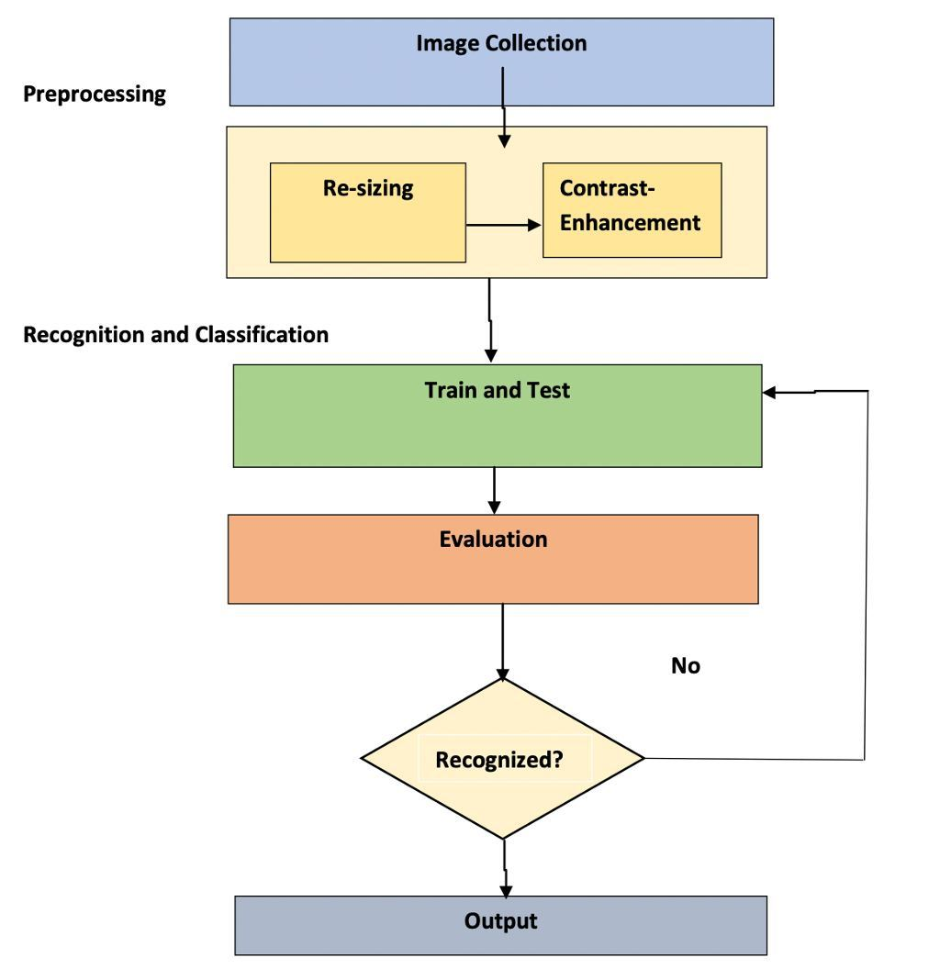
Block Diagram/Architecture

Slide 16
Results
This is a Simple Flask app fitted with Deep Conv. neural network model which is able to distinguish between real-world images of Apples, Bananas, Oranges with predicting weather the fruit in the image is Fresh or Rotten with respective probabilities.

Slide 17
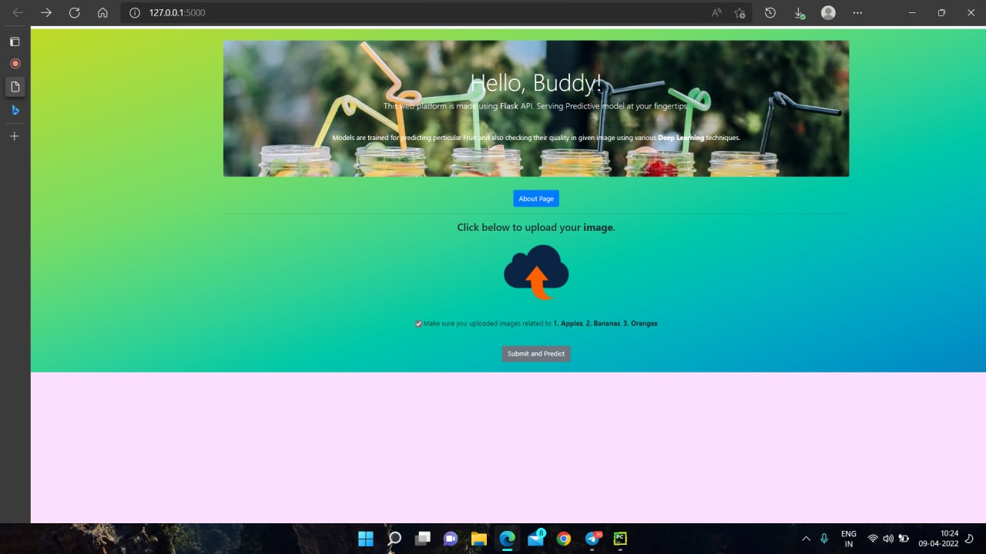
Results

Slide 18
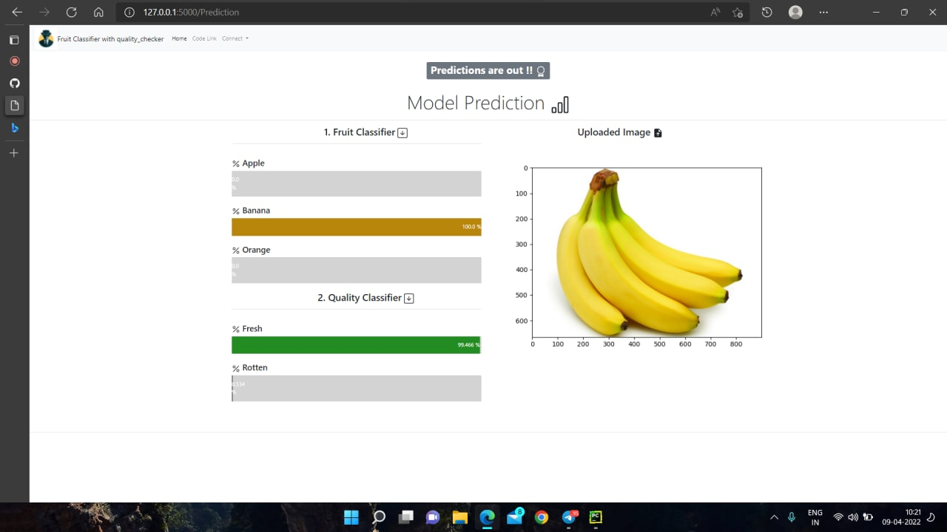
Results

Slide 19
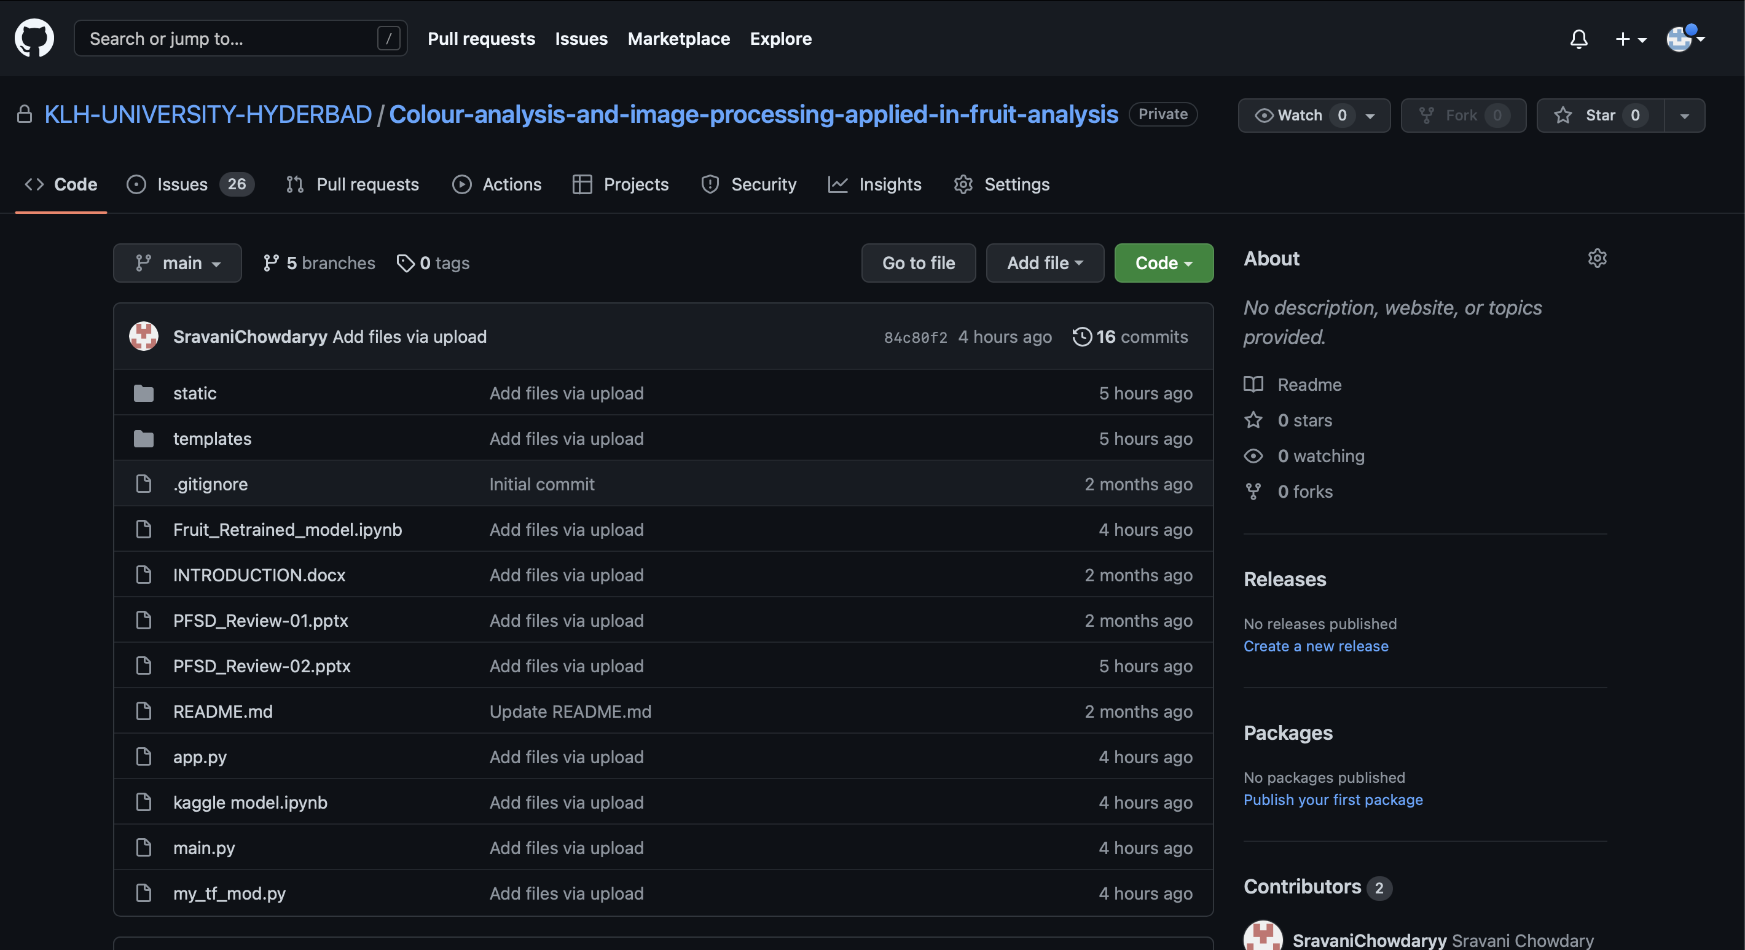
Github Setup

Slide 20
Applications
Fruit and vegetable classification is one of the major applications that can be utilized in supermarkets to automatically detect the kinds of fruits or vegetables purchased by customers and to determine the appropriate price for the produce.
An early detection system of fruit diseases can aid in decreasing such losses and can halt further spread of diseases.

Slide 21
Conclusion
This project explores a fruits recognition classifier based on the CNN algorithm. The accuracy and loss curves were generated by using various combinations of hidden layers for five cases using the fruits-360 dataset. The recognition rate has greatly improved throughout the experiment. This type of higher accuracy will cooperate to stimulate the overall performance of the machine more adequately in fruits recognition.

Slide 22
Future Scope
Hopefully, in the future, can be extended the work with a larger dataset having more categories fruits &vegetables..
Have the plan to implement some other CNN based models to compare the accuracy on the same dataset.
Can be also work on some more features for grading and classification, which can identify types of disease and/or texture structure of fruits. All these are future direction.

Slide 23
References
[1] Vartak, Akshay P., and Vijay Mankar. "Colour image segmentation-a survey." International Journal of Emerging Technology and Advanced Engineering 3, no. 2 (2013): 681-688.
[2] Dubey, Shiv Ram, and Anand Singh Jalal. "Application of image processing in fruit and vegetable analysis: a review." Journal of Intelligent Systems 24, no. 4 (2015): 405-424.
[3] Veerapur, Krutika A., and Ganesh V. Bhat. "Colour Object Tracking On Embedded Platform Using Open CV." International Journal of Recent Technology and Engineering (IJRTE) 2, no. 3 (2013).
[4] Xiaoyang Liu, Dean Zhao,Weikuan jia, Wei Ji, Yueping Sun, “A Detection Method for Apple Fruits Based on Color and Shape Features” , IEEE Access, 22 May 2019.

Slide 24
Thank You

